Slide 1
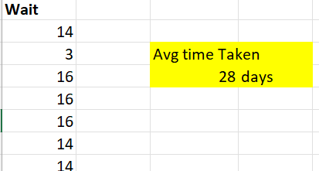
Ques1
=AVERAGE(A2:A1001)
Avg lead time between reqdate and completion date was 28 days approx.

Slide 2
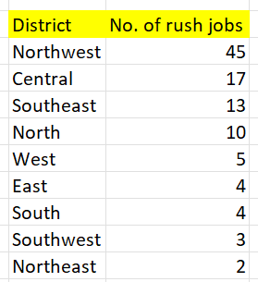
Ques2
Among a total of 103 rush jobs, 45 jobs were from northwest alone. Which is also the highest

Slide 3
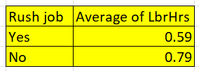
Ques3
If there is a rush job then avg labour hour decreases to 0.59 compared to 0.79 when it is a non rush job

Slide 4
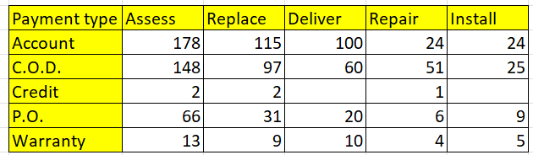
Ques4
Distribution of payment type among diff services. Maximum payments were made by “account” and Least payments were made by “credit”

Slide 5
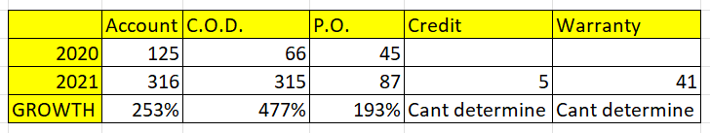
Ques5
We saw a growth in “account” payment from 2020 onwards, whereas “Credit” and “warranty” payments saw a spike of growth from almost 0. Other payment methods also grew well along with others. In the table we can also see the growth from previous year

Slide 6
Ques6
We are seeing this -1% corelation between Cost of parts and technician required
But we also need to note that there are many outliers in the data when the parts cost are 20-50 and 100-250

Slide 7
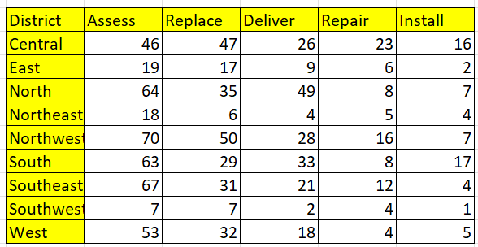
Ques7
Apart from Central district everywhere “Assess” service is most requested. But in Central district “Replace” service is more requested

Slide 8
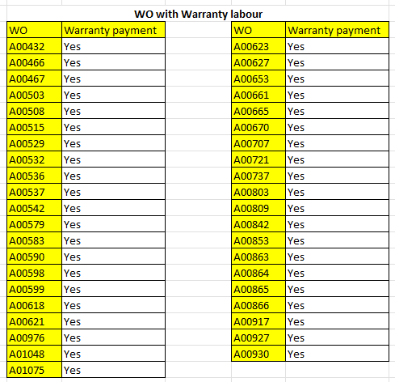
Ques8
Out of all the data, there were 41 work order with warranty labour and all those payments was done via “Warranty” method
959 Work orders were without warranty labour, and they were paid via other payment methods except “warranty”

Slide 9
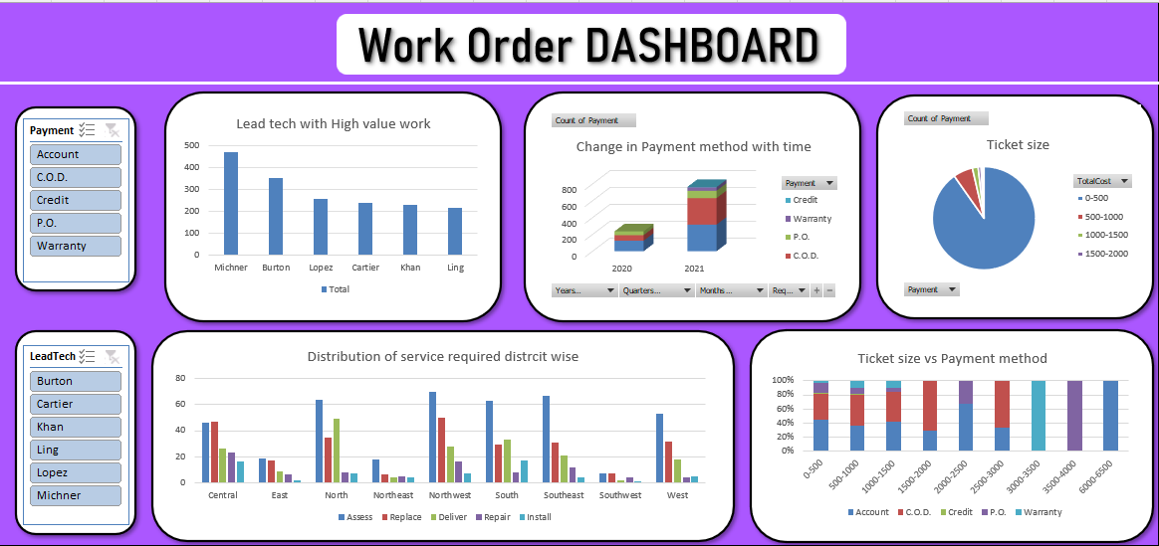
Ques9
Next slide also
Total WO | Average of LbrHrs | Sum of PartsCost
1000 | 0.77 | 195184.97
JOB | Number of Jobs Completed
Completed | 858
Not Completed | 142

Slide 10
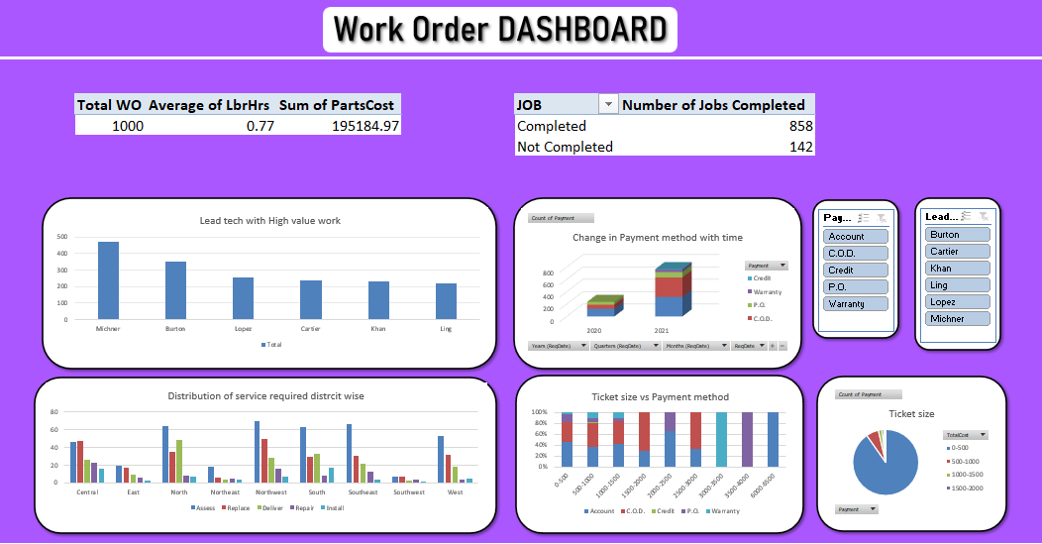
Ques9

